Slide 1

Dynasty Cars Inventory Management System
CPT-200

Slide 2
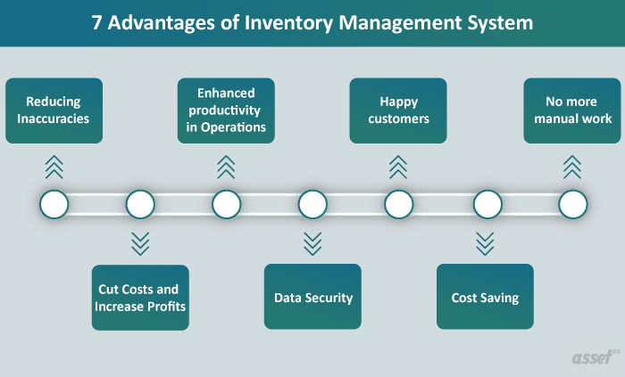
System Design Document- The What and Why?
Replace Current Tracking system used by Dynasty Cars
Improve capabilities in inventory management, tracking, and reporting.

Slide 3

System Design Document (cont’d)
System Overview
The features added will allow Dynasty Cars to quantitatively track the most popular searches, and in turn stock the lot for the future appropriately.
Per customer feedback online-navigate the car lot before approached by salesperson.
This will allow the customer breathing room on the lot to find what they need without salesperson.
Database Design
The IMS tool will incorporate existing inventory data in the archived database into a new database with additional capabilities such as searchable and sortable fields and various enhanced reporting functions.
The IMS database will also have the capability of importing and exporting data from/to MS Office Excel applications

Slide 4




Roles and Responsibilities
Leo Parker
Heather Ryan
Jason Murley
Amanda Fritz
GUI setup, R & D, and coding
Manage GitHub, PPT presentation, Gantt Chart, final submittal of all documentation
Abstract Car Class
UML Diagram, Database Cleanup, and Coding

Slide 5
Design Constraints
Schedule- Due to the time constraint of 7 weeks to complete this project our team has run into conflicting schedules.
Software Compatibility- The IMS tool must be compatible with existing user software applications. Wrong Java JDK
Experience – CPT-200 team has limited experience, as our team only has entry-level experience in both project management and coding.

Slide 6
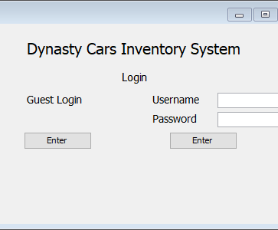
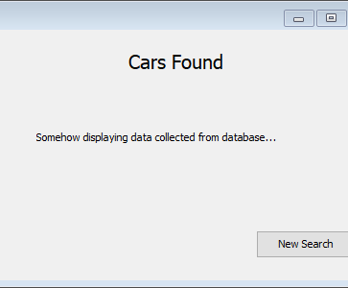
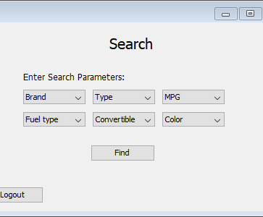
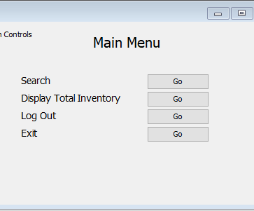
First Draft of GUI
The guest search function will allow them to add up to six characteristics they are looking for.
The admin login will present the user with more options such as Display Total Inventory.
Guests will be able to login and search without entering any data while Admins will need to submit their username and password.
This page will display data based upon what was entered on the search page. It will pull from our data base and present cars that match specifications.

Slide 7
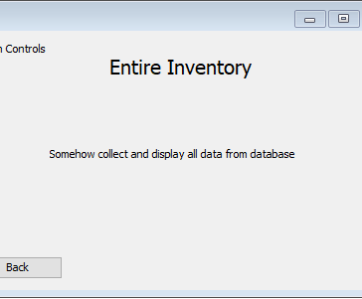
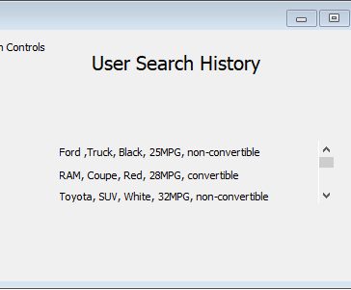
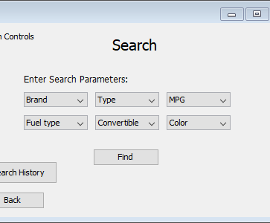
First Draft of GUI (cont’d)
Being an admin will give you an extra option in the search page which allows you to view the search history of all users.
Overall, the admins will have multiple abilites that allow them to gather more advanced data on what customers want.
This will allow an admin to browse the entire database via a scrolling menu once we have the database interacting with the program.
The User Search History page will display all past searchs in order of latest to earliest.
Guest will be able to search for the car lot without the hassle of having to create a login and password.

Slide 8
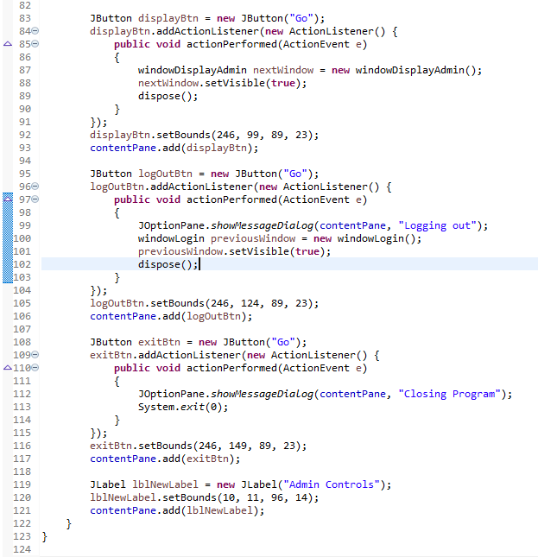
How it's built
Tools
Performance
Swing
SWT
Window Builder
Absolute layout, JLabel, JTextfield, JPasswordfield, Jbutton
Uses "JFrames" for each popup and window
Allows utilization of commands like .setVisible and dispose(); to go traverse the program
Using these commands saves resources by destroying any frames that are not currently being used

Slide 9
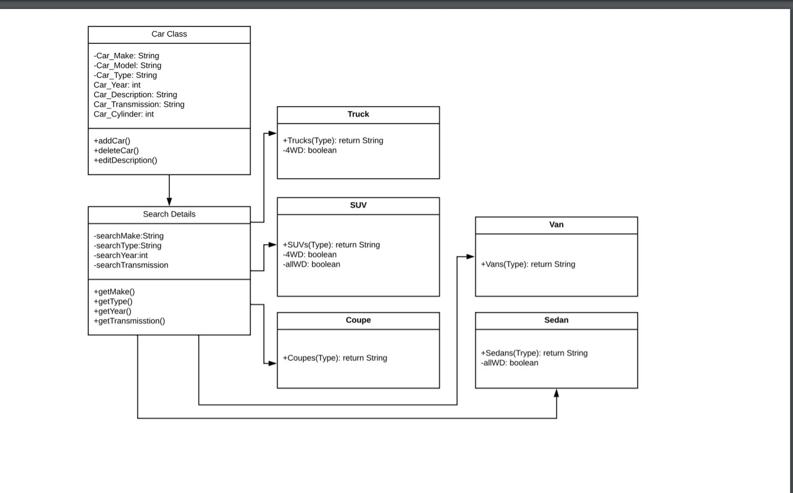
Slide 27
UML Diagram

Slide 10
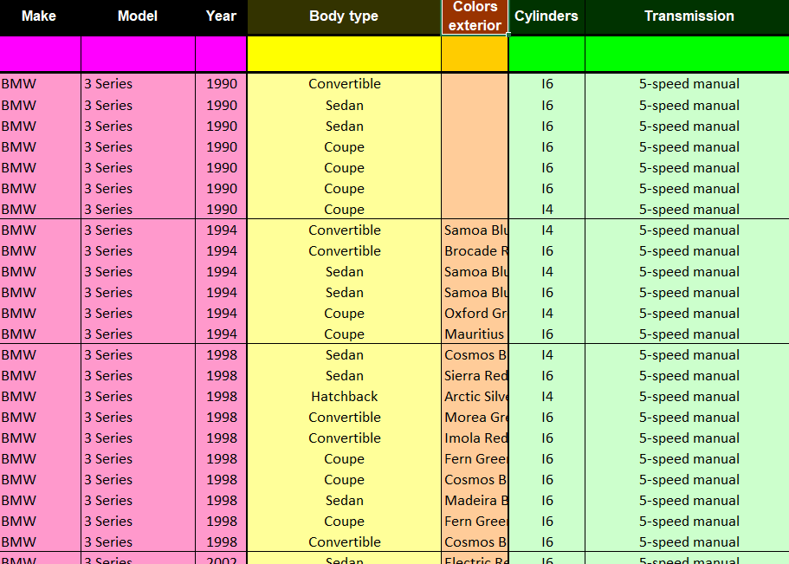
Data Base:
Using Microsoft Excel: Import Car Data
Data is Broken up into Make,
Model, Year, Type, Color, Cylinders, Transmission
Referenced: Teoalida - cardatabase.teoalida.com

Slide 11
Hardware
Software
Dell PowerEdge T30:
server for multiple users to access database
(Employees)
4 TB SAN Storage Devices
storage for database
Dell P3000 Workstations:
Single user access (customers)
Eclipse:
create code
Java:
code language
Swing:
produce GUI
GitHub:
share project progress
Microsoft Office:
powerpoint presentation
database

Slide 12


